Slide 1
Linear Regression Analysis of comR genes on natural competence of Streptococcus sobrinus
Presenter: Zong Fan
Email: zongfan2@illinois.edu

Slide 2
Problem Background
Natural competence: bacteria take up DNA from environment
2 comR genes (comR1, comR2) regulate the natural competence of Streptococcus sobrinus.
There are 3 genotypes for comR genes in this bacterium:
wildtype (wt): number of gene is unmodified.
knockout (ko): gene is deleted from the genome.
over-expression (oe): multiple copies of genes are complemented.
Natural competence could be assessed by transformation assays.

Slide 3
Purpose of study
Quantify the effect of comR1 and comR2 in regulating the natural competence
Explore whether different genotypes of comR1 and comR2 changes the ability of natural competence.

Slide 4
Methods
We apply linear model with interaction and blocking factors to fit the the relation between the comR genotypes with observed data of transformation efficiency.
The task is to find the coefficient of each term.
β0: intercept;
βb: coefficient of effect representing the differences between dates of experiment runs;
β1: coefficient of effect of comR1;
β2: coefficient of effect of comR2;
β12: coefficient of effect depending on both comR1 and comR2

Slide 5
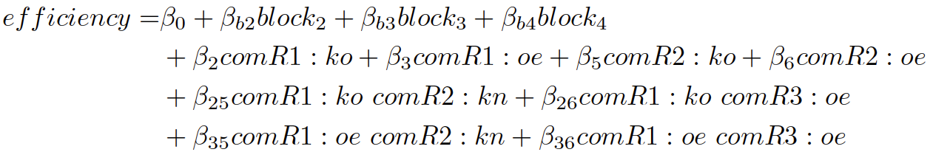
Fitting model with categorical variables
The genotypes (3 classes of each gene) and blocks (4 factors) are treated as one-hot encoded variables.
To find unique coefficient for each term, drop one in each set of variable to make coefficient matrix full-rank: block1, comR1:wt, comR2:wt.
The full format of model equation is:
(1)

Slide 6
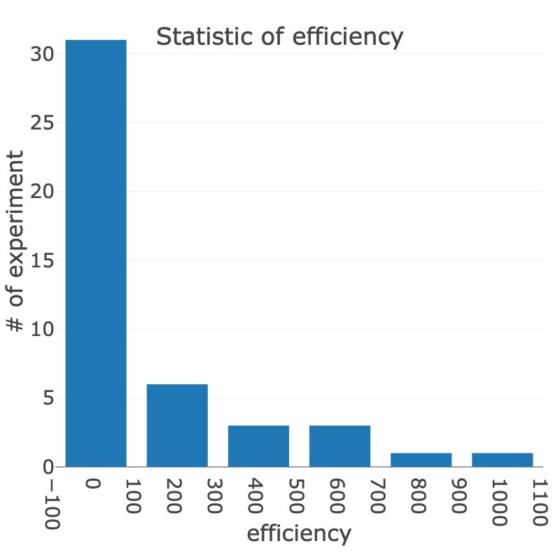
Data
45 experiments was conducted and efficiency data was collected.
 | class | # of experiments
comR1 genotype | wt | 21
 | ko | 12
 | oe | 12
comR2 genotype | wt | 21
 | ko | 12
 | oe | 12
block | F21 | 21
 | F22 | 9
 | F23 | 9
 | M24 | 6
Statistic of the number of genotypes of comR1 and comR2 and block in all experiments
Statistic of the number of efficiency of all experiments (bin width=200)

Slide 7
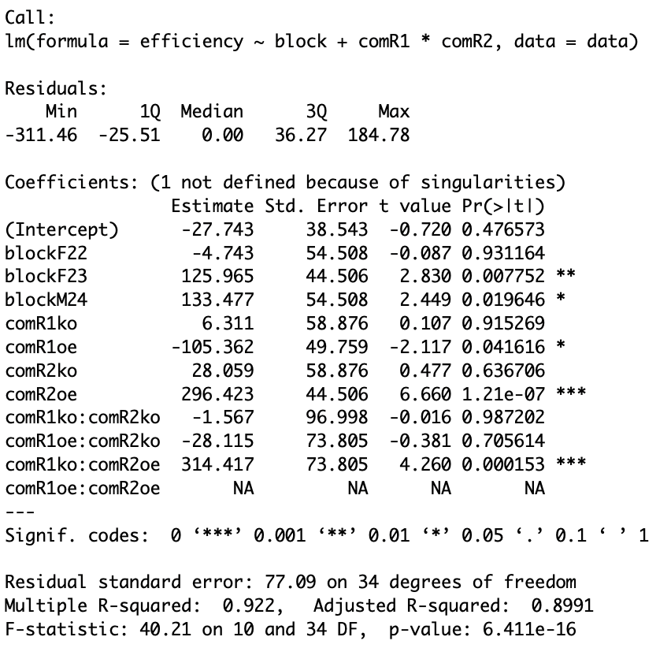
Results
1. linear model fitting raw efficiency data
Coefficients of equation (1) are shown in the first column:
significant blocking factors:
F23
M24
significant genotypes:
comR1:oe
comR2:oe
significant genotype interactions:
comR1:ko comR2:oe
LM fitting result in R using raw data

Slide 8
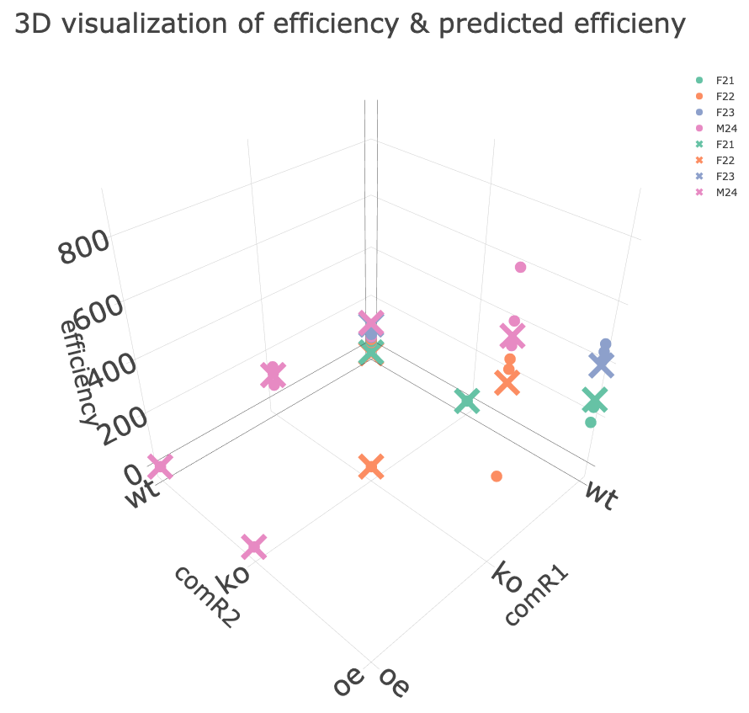
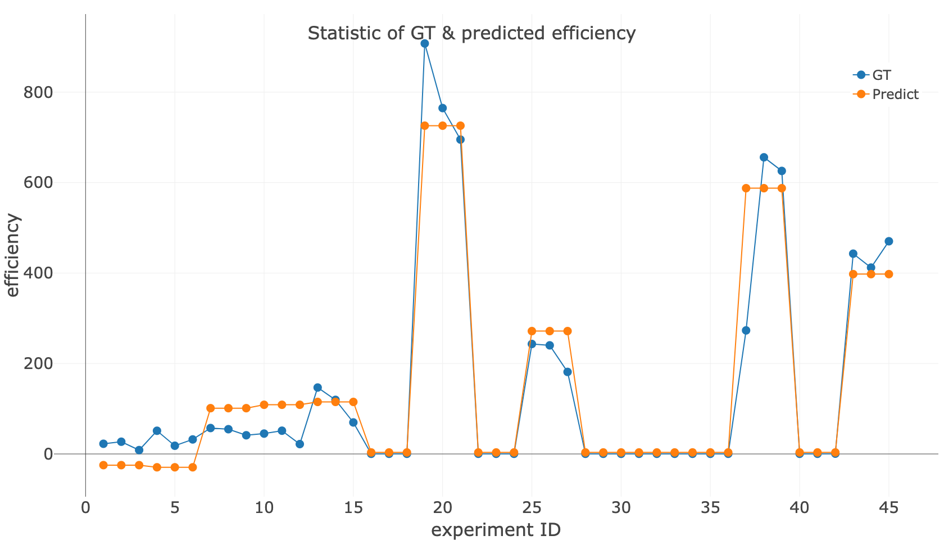
Ground-Truth vs Predicted efficiency with LM
Compare GT efficiency with predicted efficiency on the same block and genotype combinations in data using fitted LM.
circle represents GT efficiency values; cross represents predicted efficiency value
GT vs predicted efficiency in 45 experiments

Slide 9
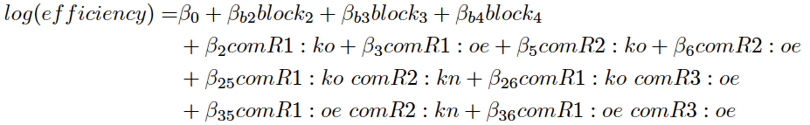
2. Linear model fitting log transformed efficiency data
Because efficiency data show skewed distribution that most of the values condense within [0, 100], logarithm transformation of efficiency is employed to alleviate the impact of skewness.
The equation format is reformated as:
(2)
For evaluation and prediction, the LM prediction output should be restored to original scale via exp(y).

Slide 10
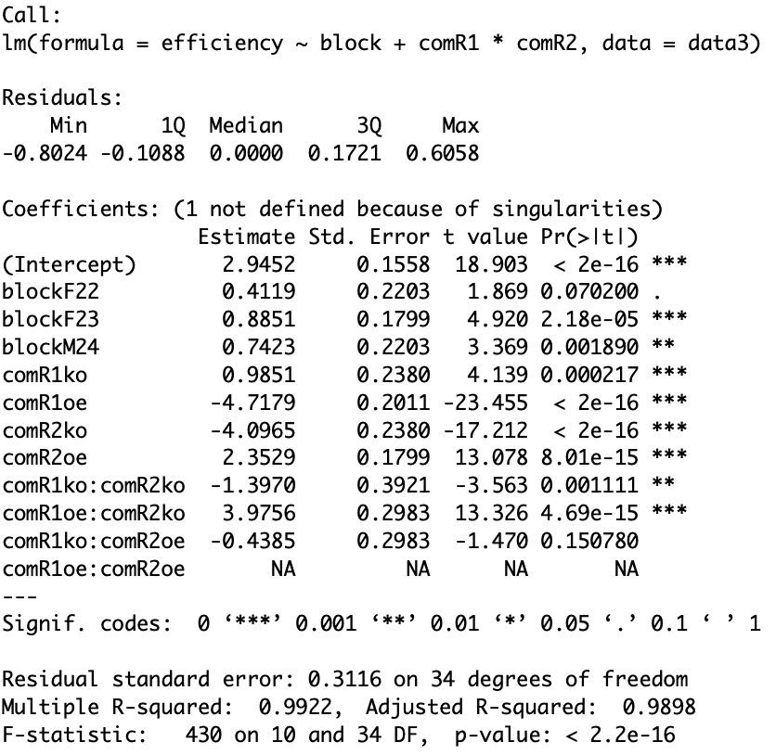
Log transformation fit data better
Coefficients of equation (2) are shown in the first column:
significant intercept
including effect of comR1:wt, comR2:wt, F21. It presents the effect of wt genotype.
significant blocking factors:
F23
M24
significant genotypes:
comR1:ko
comR1:oe
comR2:ko
comR2:oe
significant genotype interactions:
comR1:ko comR2:ko
comR1:oe comR2:ko
LM fitting result in R using log transformed data

Slide 11
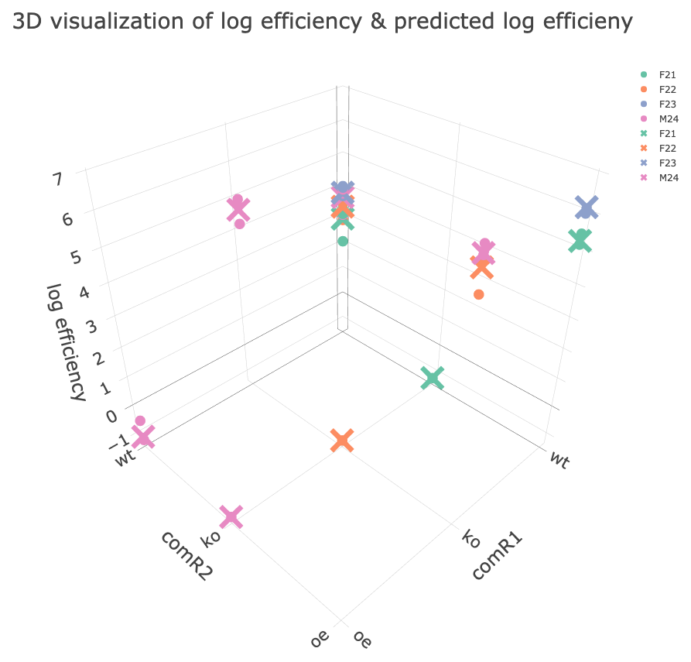
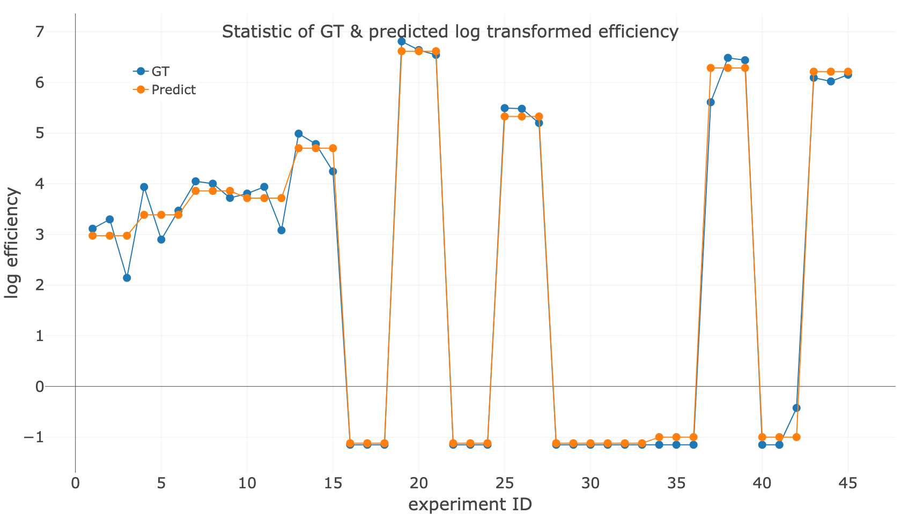
Ground-Truth vs Predicted efficiency with log LM
circle represents GT efficiency values; cross represents predicted efficiency value
GT vs predicted efficiency in 45 experiments

Slide 12
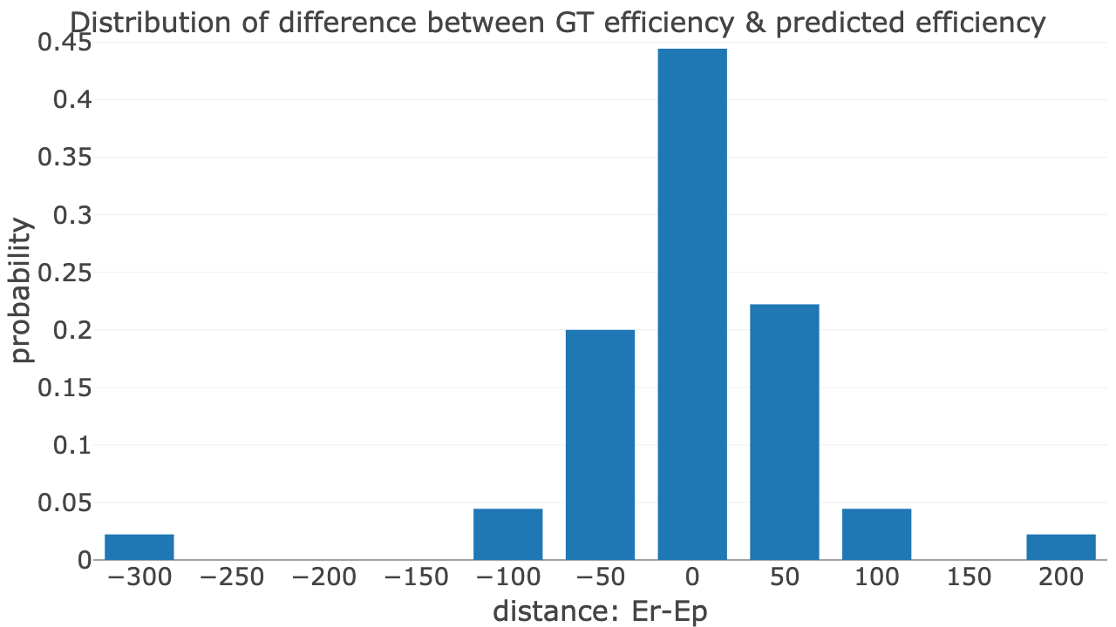
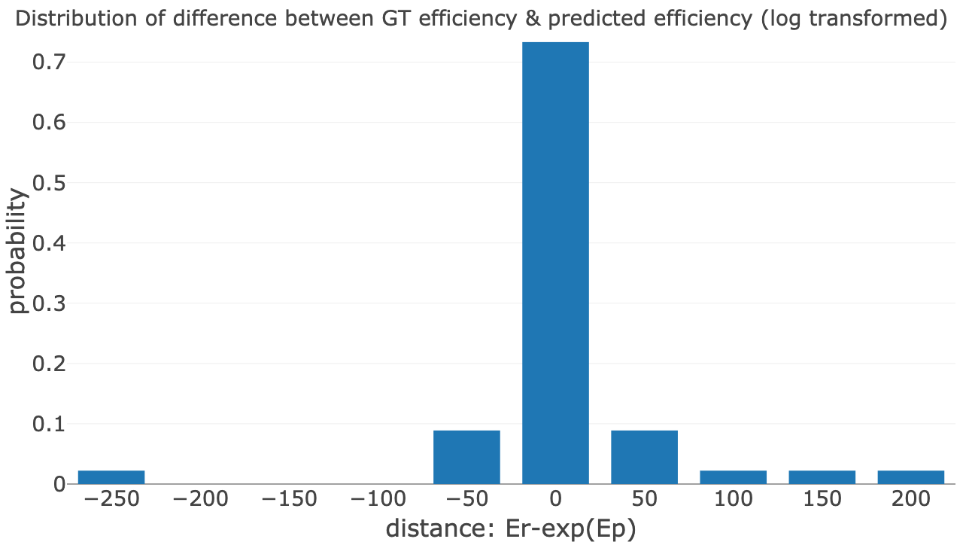
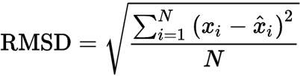
3. Log transformation improved model performance
Probability histogram of discrepancy between GT vs predicted values using LM
Probability histogram of discrepancy between GT vs predicted values using log transformed LM
The discrepancy between GT efficiency and predicted efficiency are more condensed within
[-25, 25] by use of log transformation (0.71 vs 0.44). Their Root mean square deviations (RMSD, as equation below) are 67.0 vs 56.2.

Slide 13
4. Genotype effect analytics
Genotype comR1:ko has positive value (0.985) while comR1:oe is negative (-4.718), indicating comR1 seems to inhibit the natural competence.
Genotype comR2:ko has negative value (-4.097) while comR2:oe is positive (2.353), indicating comR2 seems to promote natural competence.
comR1 and comR2 have significant interaction effect.
comR1:ko comR2:ko is negative (-1.397).
comR2:oe comR2:ko is positive (3.976).

Slide 14

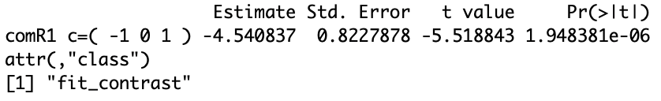
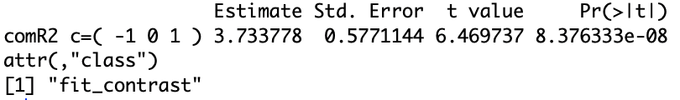
Comparison of genotype oe vs wt
To test whether genotype oe has different level of natural competence compared with wt, contrast analysis is applied.
The null hypothesis is
comR1:
comR2:
For both comR1 and comR2, genoytpe oe has significantly different level of natural competence with wt.

Slide 15
Conclusion
Logarithm transformation of efficiency could improve fitness of linear model in experiment data.
Both comR1 and comR2 has significant impact on natural competence of the bacterium. Also, these 2 genes have interaction effect.
For both comR1 and comR2, genotype over-expression has significantly different level with widetype.

Slide 16
Discussion
Effect of comR1:oe comR2:oe is unable to be estimated with given data. More experiments of this genotype should be conducted.
The comR1 seems to have negative effect on natural competence, while comR2 seems to be positive. However, in this case, interactive comR1:oe comR:ko should be negative theoretically, whereas it is positive in our model. Deeper analytics should be employed to explore the relation of the 2genes.

Slide 17
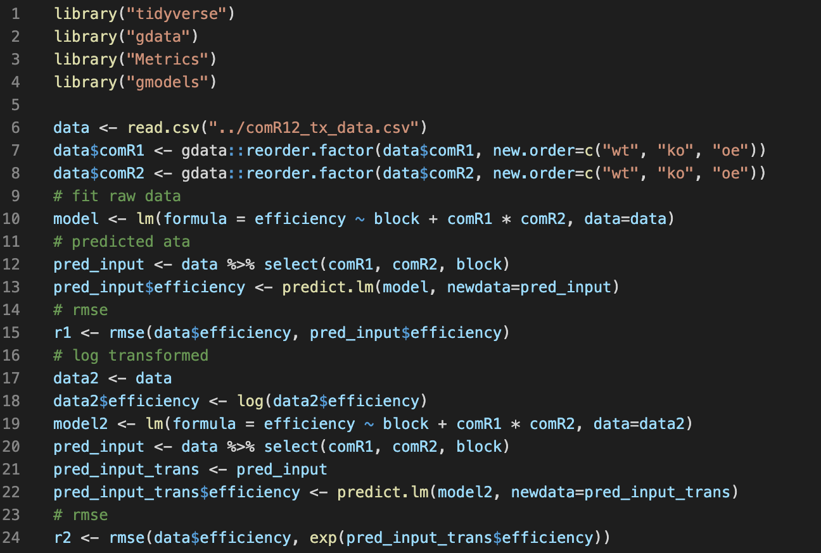
Appendix: LM fitting code

Slide 18
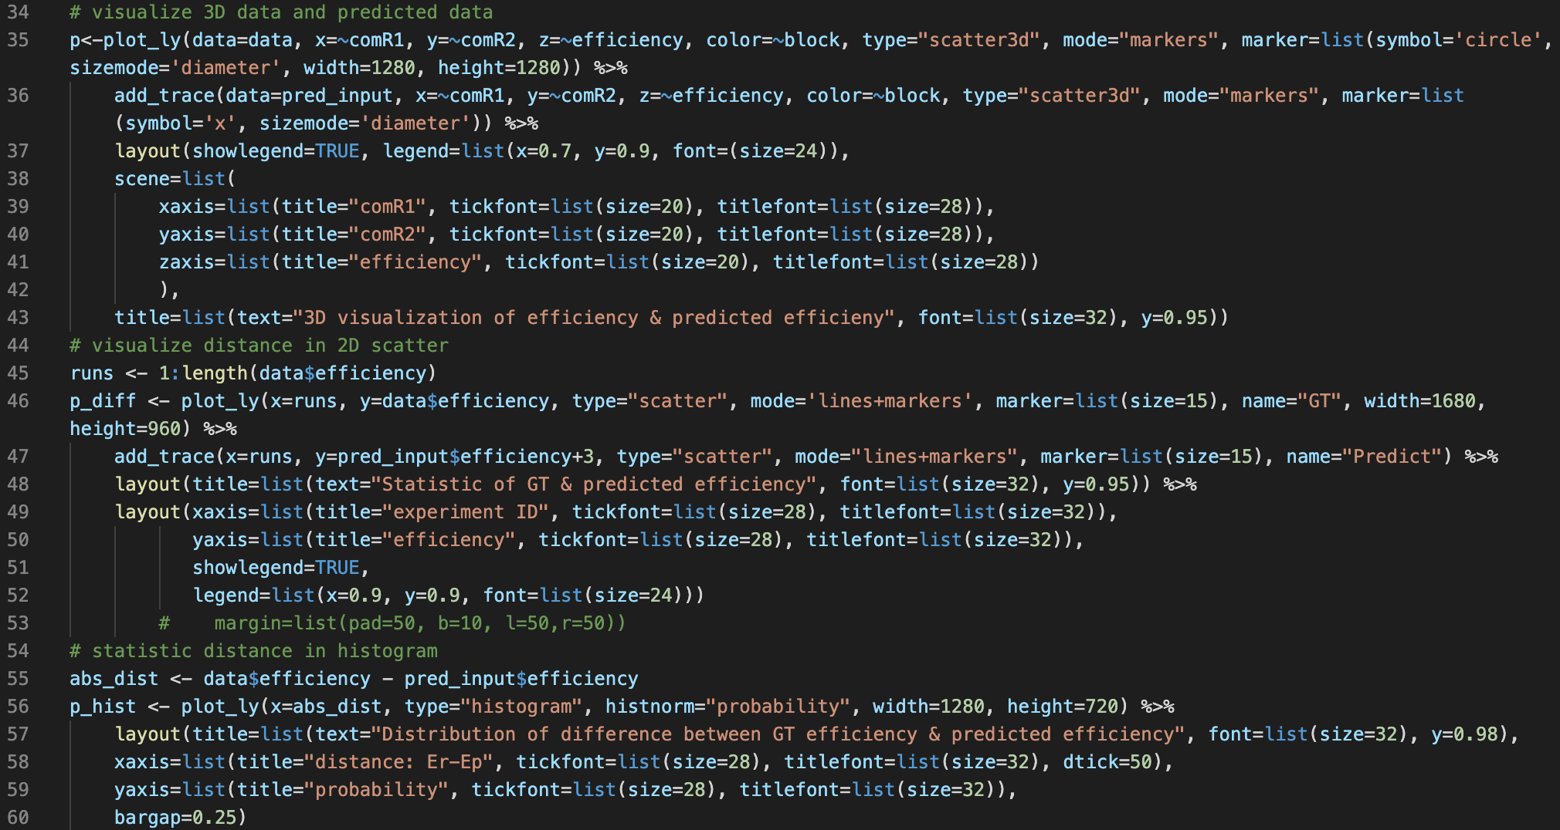
Visualization code

